Slide 1
Supply Chain Management
Workshop
Buenos Aires, 13 de Agosto de 2004

Slide 2
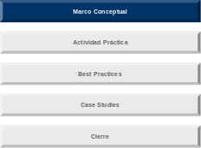
Marco Conceptual
Supply Chain Management Overview
SCM Processes: Planning
SCM Processes: Order Fulfillment
SCM Processes: Procurement
Notes:
First, we will answer the question, “What is Supply Chain Management?”

Slide 3





Overview
Supply Chain Management
What is Supply Chain Management?
Supply Chain Management is the operation of processes which enable the flow of materials, information and money between suppliers and customers to achieve desired business results.
Supply
Collaboration
Business
Partners
Performance Management
H`
Planning
Order
Fulfillment
Customers
Procurement
Suppliers
& Vendors
Financial Management
Demand
Collaboration
Notes:
The core points to emphasize on this definition slide are:
What Supply Chain Management is:
- Supply Chain Management (SCM) is more than management of inventory.
What it covers:
- SCM defines processes that manage the movement of material, information and money between customers, DLA and suppliers.

Slide 4
Overview
Supply Chain Management
Why is Supply Chain Management important?
The Supply Chain directly affects customer satisfaction and influences sales, costs, and the efficiency and effectiveness of how we obligate our funds. Supply Chain Management helps balance costs & benefits
Supply
Collaboration
Business
Partners
Performance Management
H`
Planning
Order
Fulfillment
Customers
Procurement
Suppliers
& Vendors
Financial Management
Demand
Collaboration
Notes:
What Supply Chain Management affects:
- SCM processes have the greatest impact on customer satisfaction and our financial and operational performance.

Slide 5
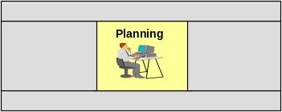
Overview
Supply Chain Planning Process Components
Supply Chain Planning is the management of information, materials and finances across customers and suppliers to ensure optimal performance.
Demand Planning
Working with customers and historical data to determine needs.
Supply Planning
Working with existing capabilities and suppliers to obtain materials to meet needs.
Demand / Supply Alignment Process
Integrating consensus demands with available supply, managing allocations of constrained items.
Operating
Principle
Manage the flow of demand and supply information across the supply chain to maximize customer service, while achieving best overall value for both customer and manufacturer
Notes:
Supply Chain Planning is the central process of Supply Chain Management. It orchestrates the other core processes of procurement, order fulfillment / customer service and the financial management (budgeting) processes.

Slide 6
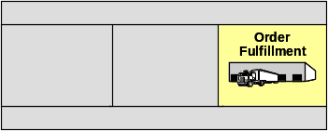
Order Fulfillment assures the delivery of goods and services in accordance with customer expectations and service level commitments. It also plays a central role in customer relationship management.
Overview
Order Fulfillment Process Components
Customer Order Fulfillment
Meeting customer needs for timely, accurate, and complete fulfillment of demand within available capabilities.
Transportation Management
Managing logistics processes associated with the movement of goods between suppliers and customers.
Distribution
Designing and managing logistics networks to optimize cycle times and costs.
Inventory Management
Managing the on-hand levels, physical control and positioning of available stock.
Accounts Receivable
Determining customer bills and performing collections.
Operating
Principle
Manage the customer service relationship for fulfillment of demand in accordance with service level commitments.
Notes:
Order Fulfillment is the set of activities that assure the actual delivery of goods and services to the customer. As such, it is the process which interacts most directly with the customer, and therefore can provide the greatest insight into customer satisfaction and future needs.
The Order Fulfillment process incorporates the physical distribution processes, as well. These are core to assuring that the goods move successfully from supplier to customer.

Slide 7
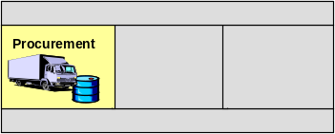
Procurement focuses on obtaining materials to meet demands, while improving overall Supply Chain performance.
Overview
Procurement Process Components
Supplier Management
Identifying and qualifying suppliers, then managing their performance through contracts and service level agreements.
Supplier Collaboration
Providing customer demand information to suppliers, understanding supplier capacities and capabilities and working together to optimize customer fulfillment.
Accounts Payable
Management of financial commitments to suppliers, and execution of payments.
Operating
Principle
Obtain the greatest value, highest service sources of supply which provide quality products and continuity of supply.
Notes:
Procurement begins with the traditional responsibility of identifying and securing sources of supply. But in a comprehensive Supply Chain context, Procurement accomplishes more. The Procurement process is responsible for establishing a collaborative relationships with suppliers.
Collaboration requires understanding supplier capabilities and willingness to partner with DLA and our customers in material planning and supplier resource scheduling to improve the efficiency of goods delivery.
While procurement is focused on the supply base, it is also cognizant of the customer as the source of demand, and works with suppliers to integrate customers into customer service objectives.

Slide 8
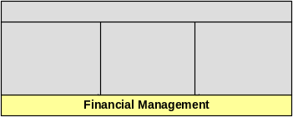
Overview
Financial Management Process Components
Financial Management in the Supply Chain aligns budgeting, pricing and cost management with overall business objectives.
Budgeting
Establishing revenues and material budget commitments necessary to meet customer requirements.
Product Pricing
Understanding and setting fair and competitive value for products.
Cost Management
Measuring, analyzing, and improving cost of operations.
Operating
Principle
Manage financial management processes to maximize delivery of best value solutions to the customer, while minimizing total supply chain costs.
Notes:
The key point here is:
Financial management is a full, critical component of effective supply chain management. In many supply chain networks, financial management is an afterthought, or is considered an independent, parallel operation. The efficient supply chain integrates and utilizes the budgeting, pricing and cost management processes in planning, procurement and order fulfillment activities.

Slide 9
Overview
Business Objectives
What is a business objective?
A business objective defines the desired performance result for the enterprise. We are interested in those objectives that are met through Supply Chain Management.
Why do we need business objectives?
Business objectives determine the scope and need for change within a company’s business practices – including supply chain practices.
Notes:
There is an opportunity to specify business objectives in supply chain terms. For example, rather than simply saying “reduce working capital (inventory),” specify customer and supplier facing efforts to actually effect the reduction.
Whenever possible, business objectives should be defined in terms that relate to supply chain activities.
- For example, a business objective might be to “increase sales by improving customer on-time, complete shipments.” The root business objective is to increase sales. One of the approaches may be tied to it.

Slide 10
Overview
Relationship between Business Objectives and Supply Chain Processes
Business
Model
Supply Chain
Model
Stakeholder
Value
Added
Business
Levers
Operating
Levers
SC Value
Levers
Supply Chain
Core Processes
Sales
Actions to improve
core
processes
Demand Planning
Supply Planning
Demand/ Supply Alignment
SC
Planning
COGS
Supplier Mgmt.
Supplier Collaboration
Accounts Payable
SVA
Costs
Procurement
Achieve
Supply
Chain
Excellence
KPI’s / Metrics
Operating Expenses
Customer Order Fulfillment
Transportation Mgmt.
Distribution
Inventory Mgmt.
Accounts Receivable
Order
Fulfillment
Plant, Property & Equipment
Capital
Inventory
Budgeting
Product Pricing
Cost Mgmt.
Financial
Management
Notes:
Called the “two-headed” DuPont diagram, this graphically connects the CFO agenda to the COO agenda, or more simply, connects business drivers of success with supply chain / operations actions.
This model allows us to perform “TRADE-OFF” analysis among alternatives for fulfillment of customer requirements, and optimization of supply chain processes.
Narrate the chart with a few examples:
Better demand planning drives higher customer fill rates and satisfaction, which logically drives increased sales. Better demand planning for DLA-direct items also reduces inventories which improves capital efficiency.
Engaging in long term contracts for materials helps to reduce costs in both cost of goods sold (COGS) through better pricing negotiation, and in reduced Sales, General and Administrative (SG&A) costs.
Some Customer Satisfaction requirements are only achieved through business practices which appear to be fiscally inefficient.
- OPERATIONAL READINESS is one example. However, upon deeper consideration, the following analysis is more accurate: if we fail in operational readiness, our customer likely must either suffer the consequences of unfulfilled needs (the costs of which – in times of war, for example – could be extremely high), or our customer must secure materials from alternate sources at much higher costs. Operational readiness (translation: inventory) is – overall – the lower total cost approach to meeting customer needs, and therefore is consistent with the DuPont model.

Slide 11
Stakeholders seek enterprise success through achievement of financial objectives. These include increasing revenue (sales), reducing costs, and optimizing the use of financial resources (capital).
Overview
The left side of the model is concerned with business/financial outcomes
Stakeholder
Value
Added
Business
Levers
Operating
Levers
Key definitions
Stakeholder Value Added
The Stakeholder’s measurement of our success.
Business Levers
The components of performance which we focus on to achieve Stakeholder measures.
Operating Levers
Specific supply chain actions which are taken to improve Sales, reduce costs, optimally use capital.
COGS
Cost of Goods Sold: What we pay for the material we sell.
Operating Expenses
Sales, General and Administrative expenses: The costs of people, business supplies and other items which go into the Cost Recovery base.
Capital
The value of inventory (working capital), the value of Plants, property and equipment (fixed capital).
Sales
Actions to improve
core
processes
COGS
SVA
Costs
Operating Expenses
Plant, Property & Equipment
Capital
Inventory
Notes:
From the left side, moving to the right, I will explain the business model:
Stakeholders seek to maximize the value of the enterprise.
This is accomplished by focusing on core business levers, which reflect traditional financial metrics seen on income statements and balance sheets (‘top line’ revenue or sales, management of costs, effectiveness of capital applied).
Each of the business levers may be further decomposed into their component operating levers. These are process-specific, actionable activities which will cause the business levers values to increase or decrease.

Slide 12
Similar to the way the Business Model defines financial success, the Supply Chain Model defines the process capabilities required for operational success.
Overview
The right side of the model defines our supply chain processes
Supply Chain Model
SC Value
Levers
Supply Chain
Core Processes
Supply Chain Performance Excellence is the desired outcome for the manufacturer’s Core Processes.
Supply Chain Core Processes are the four key operating areas through which the manufacturer delivers the best value solutions to its customers.
Supply Chain Value Levers are the specific operating processes / areas within each Supply Chain core process through which we influence performance and business results.
Demand Planning
Supply Planning
Demand/ Supply Alignment
SC
Planning
Collaborative Sourcing
Supplier Management
Procurement
Achieve
Supply
Chain
Excellence
Customer Order Capture
Delivery
Customer Relationship
Management
Order
Fulfillment
Budget Planning
Product Pricing
Cost Management
Financial
Management
Notes:
From the right, I will explain the supply chain operating model:
We’ve organized our supply chain management activities into four supply chain core processes. These four processes cover the majority of the activities which drive customer satisfaction and through which we optimize our costs and service levels.
The supply chain core processes are made up of sub-processes, which we cite here as supply chain value levers. These are the specific activities we conduct to achieve the objectives of each of the supply chain processes.
Where the supply chain side meets the business operations side we define the BSM supply chain strategy. Our supply chain strategy arranges the SC value levers to achieve our business goals. Importantly, we also apply Key Performance Indicators (KPIs) in the connection between Business and Supply Chain.
This one chart helps us to connect our supply chain operations to our desired business outcomes through focusing our efforts on supply chain levers.

Slide 13
The structure helps us make the connections to answer the question, “What can my process do to deliver a desired business result?”
Overview
Direct connections between operations and business results
Business
Model
Supply Chain
Model
Operating Levers
(Examples)
SC Value
Levers
Demand Planning
Supply Planning
Demand/ Supply Alignment
Specific actions taken in the four process areas to improve a Business Lever
Collaborative Sourcing
Supplier Management
KPI’s / Metrics
Customer Order Capture
Delivery
Customer Relationship
Management
Budget Planning
Product Pricing
Cost Management
Notes:
This is the central point of the “Two-headed” DuPont diagram: it provides a framework / context through which to directly relate Supply Chain Value Levers (the principal component activities or sub-processes within each of the four Core Processes) to Business Operating Levers.

Slide 14
Marco Conceptual
Supply Chain Management Overview
SCM Processes: Planning
SCM Processes: Order Fulfillment
SCM Processes: Procurement
Notes:
First, we will answer the question, “What is Supply Chain Management?”

Slide 15
Why is Supply Chain Planning Important?
Supply Chain Planning is vital to the successful and efficient operation of a company. It ensures that timely fulfillment of customer orders is achieved.
Demand Planning:
  Determines what your customers will order in the future.
  Talks to customers to get additional information.
Supply Planning:
  Puts the right item in the right place at the right time.
  Ensures capability exists to meet customer orders.
Demand/Supply Alignment:
  Matches what my customer wants to what I can provide.
  Allocates available resources to meet customer service objectives.
  Identifies future supply requirements.
Notes:
Demand Planning:
Determines what the customers will order and when that need will occur
Involves collaboration with customers to get better information
Involves the goals of demand planning are forecast accuracy AND customer service
Supply Planning:
The organization is concerned with creating supply plans based on demand plan inputs.
They also want to ensure that correct items are available at right time.
The goals of supply planning are customer order fill and inventory turns.
Demand/Supply Alignment:
This involves a group of representatives from multiple business groups, including:
- Demand Planning
- Supply Planning
- Customer Service
- Procurement
They meet to work out issues with constrained supply.
Each group member brings views from home organization to optimize total supply chain.
The goal of Demand/Supply Alignment is to maximize customer service levels and reduce total supply chain costs.

Slide 16
Pressures in Supply Chain Planning
Getting the right product to the right place at the right time is becoming increasingly difficult as pressures grow from both the Demand and Supply components.
Demand Pressures
Supply Pressures
Smaller shipments
More complex customer requirements
Shorter lead times
Lower prices
New channels
More SKUs
Shorter product lifecycles
Increased cost pressures
VARIABILITY
Notes:
Shown here are both Demand and Supply pressures in Supply Chain Planning. Variability affects the supply chain in many ways.
As any one or combination of additional pressures are added to the planning process, variability increases.
Variability can and will affect planning successes. Some examples are:
Customer only wants to buy enough stock to cover what is needed right now. A tier 1 automotive manufacturer requires its suppliers to provide small shipments more frequently to minimize its inventory holding costs. – Smaller shipments
Customer may want orders split between different locations, specific configurations of items, etc. – More complex customer requirements
Computer chips – average of 18 month lifecycle, which must be completely planned prior to beginning – Shorter product lifecycles
There are many pressures that affect the demand and supply planning functions within an organization. As more of these items are realized, the variability associated with planning increases significantly. This variability makes it even more essential to utilize an effective planning process by the organization.
Demand Pressures include:
Smaller Shipments – Customers are requiring smaller shipments of product (only buying what they want or need)
More Complex Customer Requirements – Customer requirements are getting more complex
Shorter Lead Times – Customers demand more reactive supply chains and shorter times to delivery
Lower Prices – Lower sales prices make it vital to plan effectively to remain profitable. When a company is dealing with decreased margins, it is essential to have an accurate plan driving the organization.
Supply Pressures include:
New Channels – New channels have torn down many barriers to entry into a market. Suppliers previously unknown to the customer can now reach a much larger audience. Providing more competition for the long dominating suppliers.
More SKUs (Stock Keeping Units) – Additional product offerings add more choices to the customer, allowing his orders to encompass many different products where one product traditionally was available.
Shorter Product Lifecycles – Products are being introduced and retired more frequently, requiring effective planning to ensure that customer orders are met.
Increased Cost Pressures – Must have a balance of capacity and inventory to meet and sustain customer service levels.

Slide 17
What is Demand Planning?
The demand planning process takes all available demand signals and creates a demand plan for use by the organization.
Inputs
Create Plan
Outputs
Consumption Data
Historical Data
Collaborative Input
from Customers
Market Intelligence
Pricing
Statistical Forecast
NSO Objectives
Collaboration
Enrichment of
Demand Plan
Demand Consensus
One Number Plan
Understanding of
demand drivers
and usage
Strategic, Tactical,
and Operational
outlook
Sales Input for
Budget
Notes:
Demand Planning is the first process in Supply Chain Planning.
Demand planning benefits companies in many different industries and dynamics.
Demand planning is the first step in an effective supply chain planning process.
The demand planning process involves gathering the appropriate input sources, determining how the demand plan will be created, generating the plan, and providing the plan to the organization for use by multiple areas.
The inputs into demand planning can vary greatly. Some examples are:
Consumption Data – What did the customers actually use in the past?
Historical Data – What did the customers order from me in the past?
Collaborative Input – This is any additional information I can gain by talking to my customers. This collaborative input can come from my end customer(soldier), a replenishment facility, or even a customer segment level.
- Examples of collaboration – Maintenance plans, troop exercises, special events
Market Intelligence – This is any additional input I can utilize that will give me an indication of what is happening outside of DLA. This can include intelligence on shortages of raw materials, information on crop shortages, etc.
- Example of market intelligence – freeze will drive up orange prices, I know I will need more apples.
Pricing – Pricing of different items may help drive demand for others.
- Example of pricing - If two items are substitutable, and one is priced at twice the amount of the other, the demand for each can be affected by changing the pricing.
Let’s talk about some of the Planning Creation Processes.
There are multiple methods used to create a demand plan. Demand Planning at DLA will encompass many of these different approaches:
Statistical Forecast – Using past demand data to generate a mathematical model of future demands
NSO Objectives – Setting a stocking objective and utilizing a type of reorder point to plan for demand
Collaboration – Using inputs from my customers to drive the demand plan either in part or wholly
Enrichment of Demand Plan – Adding additional information to the plan from the market intelligence gathered
Demand Consensus – Alignment of the demand plans for all customers across the entire organization
Here are some of the outputs of Demand Planning:
One Number Plan that is used to drive the organization including supply planning, finance, etc.
Multiple time series views of the demand plan are used for the strategic planning, tactical planning, and execution of the business.
Sales estimates are provided as inputs for budgeting process.

Slide 18
Forecasting Process
Demand Planning Process
Here is an example of the Demand Forecasting Process:
Demand Forecasting
Gather Historical Consumption Data
Determine any Trends in History
Create Forecast using Statistical Models
Adjust Forecast with added Intelligence
Rationalize Forecast / Demand Consensus Meeting
Pass Forecast to supply / production planning
Notes:
Demand Forecasting is a subset of demand planning. This means that while all items/customers will have a demand plan, a forecast will only be created for a portion of the item/customer combinations.
• Demand forecasting is utilized to create a demand plan when there are enough historical data points and demands to allow a statistical model for future demands.
• Demand forecasting will be used for a subset of all DLA items.
Here is the Demand Forecasting process:
Historical consumption data is gathered from all available sources. This data can represent the customer’s actual consumption of the product, ordering data of the product, or shipment information. It is optimal to utilize the actual consumption data for the process if it is available.
The data is analyzed to determine what the trend within the data is. This trend is a general depiction of the pattern in the demand for the product. This trend can be increasing, decreasing, or flat. Different items will have different trends (e.g., cell phones – increasing trend).
After the data has been collected and analyzed, a statistical forecasting model is used to create a forecast of future demands.
The forecast is then adjusted by the planner. This adjustment can be made to change the forecast quantity to reflect a more accurate forecast. Possible updates could include hiding past historical occurrences from being picked up in the model, boosting the forecast to reflect an upcoming surge, etc.
The forecast is rationalized and consensus is reached across the entire demand planning organization on the demand plan.
The final forecast is then passed to supply planning for use in the determination of what capabilities are required to meet the future demands.

Slide 19
What is Supply Planning?
The supply planning process tells the organization what is needed, and where and when to meet customer demands.
Create Supply Plan
Inputs
Outputs
One Number
Demand Plan
Existing Inventory
Safety Stock Levels
Customer Service
Levels
Determine ability to
meet demand with
existing assets
Identify additional
capabilities required
Time Phased
Inventory Plan
Recommended
buys
Notes:
Supply planning takes several inputs including demand plans and current capabilities. It determines the organizations ability to meet the demand, and creates a time phased plan to ensure that the appropriate resources are available to meet the demands.
Inputs into the supply planning process include:
Demand Plan – final demand plan resulting from previous process.
Existing Inventory levels
Safety Stock levels
Customer Service Objectives
The supply planning process:
Maps the demand requirements with existing capabilities (inventory, supplier capacity and capability, contracts)
Identifies actions needed to ensure all demand can be met
The outputs of the supply planning process include:
Time Phased Inventory Plan(TPIP) – maps out the supply requirements (either internal or external) to meet the demand in time buckets
Recommended buys in an optimized schedule to meet demand and optimize inventories
Optimized distribution of assets to maximize customer service levels
An example of this is found in the way you manage your personal finances.
You have a plan of what money you will need for bills, food, entertainment, etc.
You have a set amount of money available in your checkbook.
You need to balance your demands against what you have available to determine if you can meet all of your demands.

Slide 20
Why Supply Plan?
Supply planning ensures that appropriate supplier capabilities and physical inventories are available in the right place at the right time.
Balance Forecasts, Orders, and Customer Service Objectives
Ensure correct capacity by location
Optimize Inventory Levels
Time Phased View of Requirements
Proactive vs. Reactive
Manage by Exception
Notes:
Supply Planning is important to an organization for many reasons. It is responsible for:
Balancing demand forecasts, existing customer orders, and customer service objectives in fulfillment of customer orders
Ensuring correct capacity is present in correct locations prior to demands
- Supply planning allows the organization to place required capabilities in place before demand arises.
Maintaining the optimal amount of inventory to meet customer service levels across the entire network, not just at a single location.
- Inventory is balanced with supplier capabilities to meet customer service levels and minimize total supply chain costs.
Providing time phased viewpoint of what will be required to meet customer orders
- It allows an organization to see supply requirements by time period – now and in the future.
Implementing a proactive approach vs. reactive approach
- It also allows an organization to prepare for demand rather than need to react once demand hits.
Providing capabilities to manage supply matters by exception, focusing effort on true problem areas
- Managing by exceptions allows an organization to maximize the results of time spent on planning.
- It focuses efforts on areas that need attention.

Slide 21
Supply Planning Process
Supply Planning Process
Supply Planning
Demand Plan
Develop Inventory Plan
Plan Inventory Deployment
Generate Constrained Resource Plan
Pass Recommended Buys to Procurement
Hold Supply Alignment Meeting
Notes:
The supply planning process is executed on a weekly basis. It answers the question: “How am I going to fulfill this demand to my customer?”
Here is the supply planning process:
Receive demand plan - The demand plan is a key input in the development of a supply plan. Additional inputs will be customer orders and due in quantities as well.
Develop Time Phased Inventory Plan - Using the inputs, along with dynamic inputs such as inventory levels and safety stocking levels, develop a weekly inventory plan. This plan shows the items needed to meet the demand plan, and provides visibility to when those items need to arrive and be purchased, based on lead times.
Pass Recommended Buys to Procurement - The recommended buys created in the supply planning process are passed to procurement for action. Procurement will ensure that these item quantities are purchased and available to meet demand at the time that the demand will hit.
Plan Inventory Deployment - Along with purchased, inventory deployments from stocking locations to other stocking locations will be created to ensure that the right product is in the right place. These deployments are also time phased, taking into account lead times, to place the right items in the right places while maximizing my customer service levels.
Generate Constrained Resource Plan - Supply plans can be constrained on any number of resources. The supply plan can be constrained, for example, on resources like dollars or capacity.
Hold Supply Alignment Meeting - A supply alignment meeting is held between the supply planning group and procurement to work out any supply issues that arise as a result of the required inventory or supplier capacity to meet the demands. This meeting strives to resolve any supply issues to ensure supply continuity to meet customer demands.

Slide 22
Why Align Demand with Supply?
Demand/Supply Alignment is utilized to determine how and which customer orders to fill in a time of constrained supply, as well as set strategic direction.
Why do I need Demand/Supply Alignment?
  To determine optimal solution in constrained situations.
  To ensure balance between customer service levels and financial objectives.
  To review performance and areas for improvement.
What timeframes does Demand/Supply Alignment look at?
  Operational, Tactical, and Strategic Time Horizons.
  Each timeframe is used to review different business issues (e.g., supplier capacity, short supply, new customer requirements, etc.).
Notes:
Demand/Supply Alignment occurs for operational, tactical, and strategic purposes.
In the short term, the alignment focuses on current issues and determining how to meet demands with constrained supply.
In the tactical view, alignment focuses on determining customer service levels and any actions needed to ensure that supply is balanced with demand, as well as creating the One Number plan used by the entire organization.
In the strategic sense, the alignment meeting sets the direction for the organization and conducts and long range supply planning requirements identification.

Slide 23
Key Elements of Demand/Supply Alignment
There are several elements required for an effective Demand/Supply Alignment process.
Accurate Data
Demand and Supply Plans
Capacity and Capability
Empowerment to Make Decisions
Authority to make decisions
Authority to act on behalf of organization
Clear Performance Measures
Must Have Shared Goals
Align Measures with Performance Metrics
Accountability for Performance
Accountable to Executives
Notes:
Accurate Data:
• An effective demand/supply alignment meeting requires accurate data inputs to be effective.
• Clear performance measurements are required to ensure that optimal decisions are made.
Empowerment to Make Decisions:
• Balance supplier capacities / capabilities, inventory levels and customer service levels.
• Commit resources to produce a given amount of product.
• Influence demand.
• Allocate product when supply constraints or demand spikes occur.
• Deploy product through Prime Vendors, Consignment or Vendor Managed Inventory.
Clear Performance Measures:
• Choose performance measures which provide meaningful insight into performance.
• Identify some performance measures as common to all teams, others as (customer, supplier, product) segment specific.
• Define all performance measures in detail and gain consensus on the definitions.
• Align performance measures with members’ evaluations criteria and incentives.
• Establish tolerances for performance of the team / individual members and establish team goals which are consistent with functional goals.
• Use performance measures to improve the process and provide feedback about when the process is not working.
Accountability for Performance:
The participants in the demand/supply alignment meeting must be accountable for the decisions made in the meeting, as well as accountable for ensuring that the optimal decisions are made for the customer and DLA.

Slide 24
Marco Conceptual
Supply Chain Management Overview
SCM Processes: Planning
SCM Processes: Order Fulfillment
SCM Processes: Procurement
Notes:
First, we will answer the question, “What is Supply Chain Management?”

Slide 25








What is Order Fulfillment?
Order Fulfillment is a process involving the assurance of customer satisfaction by delivering the right product to the right place at the right time.
Warehouses &
Distribution Centers
Suppliers
Customers
Notes:
There are three major entities within the process of Order Fulfillment – Suppliers, Distributors, and Customers.
Very simply, the fulfillment network incorporates the core DLA mission: Right Item, Right Time, Right Place, Right Price, Every time...to create the best value solutions for America’s warfighters.
As you can see, throughout the network, there are costs that accumulate, ranging from acquisition costs to distribution and transportation costs.The better the supply chain network is at containing these costs while providing reliable service, the more likely the customer is to be pleased with the fulfillment of their order requirements.
However, as you learned from the Simulation game, providing this reliable service to the customer while containing costs requires a high degree of collaboration among these entities.

Slide 26
What is Order Fulfillment?
The Order Fulfillment Process consists of a number of distinct activities that involve the management of customers and customer orders.
Order Fulfillment
Manage Customer
Profile
Manage Customer Relationships
Capture
Customer
Order
Manage
Delivery
Manage
Inventory
Manage
Accounts
Receivable
Manage
Customer
Order
Notes:
The Order Fulfillment process is made up of several distinct, but very inter-related, activities.
An important component of this diagram is the process called “Manage
Customer Relationships” (highlighted in green).
Managing Customer Relationships is an important process within Order Fulfillment because it impacts practically every other Order Fulfillment activity, and the costs associated with these activities, from the ability to capture critical customer information for us to be able to maintain customer profiles to identifying and managing delivery requirements of our customers.
Also, imagine how costly performing this activity would be if it wasn’t a coordinated process across multiple customers. It takes resources to interface with customers regarding performance and demand requirements, so coordinating activities like customer communications and having a formal process in place to do this can greatly reduce costs associated with selling and maintaining accounts. We’ll touch on this later when discussing stakeholder value.
Again, even though these appear as distinct sets of activities, they are highly related and must be integrated in order to effectively satisfy customer order requirements. A lack of integration between any of these sets of activities could result in a lack of customer satisfaction and higher costs. After that, the unsatisfied customer may go somewhere else for the product or service they are receiving.

Slide 27

The Perfect Order
The Perfect Order = The Ultimate Goal of Order Fulfillment.
  The perfect order includes the Seven Rights of Order Fulfillment:
        The Right Product
        To the Right Customer
        At the Right Time
        In the Right Place
        In the Right Condition
        In the Right Quantity
        At the Right Cost
  A “perfect order” helps an organization obtain and fill orders at the best value for the customer.
Notes:
The Ultimate Goal of Order Fulfillment is to deliver the perfect order.
And while a weapons system varies dramatically in form from simple automobile parts, the criteria used to determine a perfect order are identical in both cases.
Customers expect their orders to be filled based on successfully addressing all these criteria and, especially where there’s competition for a customer’s business, it’s even more important to build the process capabilities that drive toward delivering the perfect order.
Using the ACME situation, the Perfect Order can be illustrated:
ACME ships the correct type of radiator hoses to the Auto Parts Store,
On the Required Delivery Date specified by the Auto Parts Store,
To the correct address for the Auto Parts Store.
The hoses arrive in perfect condition because ACME used the correct packaging for shipment of the radiator hoses.
The Auto Parts Store receives the exact number of radiator hoses.
The billing invoice the owner receives is accurate.
And, the Auto Parts Store owner is happy to pay the fair price for the radiator hoses.
As a result, the Auto Parts Store owner is satisfied with the service provided by ACME and will most likely order more radiator hoses (and other auto parts) from ACME in the future.

Slide 28
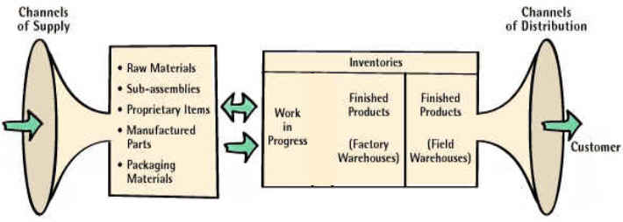
Order Fulfillment Management
In this illustration, the Order Fulfillment process is a pair of funnels that begin and end the process, with the actual work of the Order Fulfillment management activities taking place in the middle.
Order Fulfillment Management
Channels of Communication
Notes:
The Order Fulfillment process begins with channels of supply that provide raw materials and manufactured parts, which are inputs to the distribution channels that are used to distribute products to customers.
This chart actually applies to both Customer Direct and DLA Direct channels. In a Customer Direct channel, where the supplier is responsible for shipping directly to the customer and the product is not stored in a DLA warehouse, the supplier is responsible for maintaining any inventory that is necessary to meet the customer’s requirements.
In a DLA direct channel, the item is owned by DLA and DLA is responsible for meeting the customer’s requirements.
What’s important is that the customer will deviate to the product source that consistently and reliably meets their needs at a fair price. This is known as Customer Loyalty. -- If you are a satisfied customer, you will not take the risk of trying another company. Having an effective Order Fulfillment process that results in high customer satisfaction will most likely create the customer dependency that all suppliers want to achieve.

Slide 29
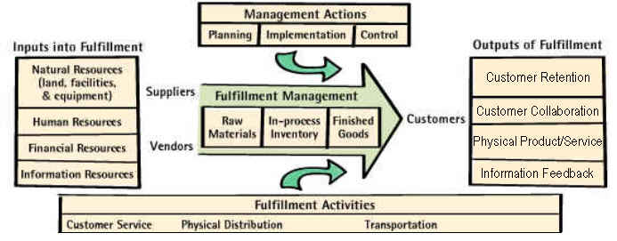
Order Fulfillment Management
Effective Order Fulfillment management requires understanding all the inputs into the Order Fulfillment process.
Notes:
Effectively managing the order fulfillment process requires understanding all the inputs into the fulfillment process, whether they’re capital or labor-related, as well as all the activities involved in fulfilling customer orders.
These Order Fulfillment activities are generally categorized as customer service, physical distribution or transportation-related. Understanding these activities, as well as how they contribute to the overall cost and functioning of the Order Fulfillment process, is critical to efficiently meeting customer requirements.
In this regard, effectively understanding what Order Fulfillment assets are required, implementing plans that effectively and efficiently match assets to customer requirements, and monitoring and controlling all Order Fulfillment activities, is a must for ensuring high customer service and keeping costs under control.

Slide 30
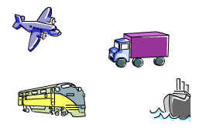
Order Fulfillment Management
Here are the Order Fulfillment Activities Within Order Fulfillment Management.
Physical Distribution
  Return Goods Handling
  Network & Facility Planning
  Materials Handling
  Distribution Information Systems
Customer Service
  Order Management
Transportation
  Carrier Management
  Load Planning
  Traffic Management
  Routing and Scheduling
  Transportation Information Systems
Notes:
As I mentioned, Order Fulfillment activities are categorized as Customer Service, Distribution or Transportation related.
Order Management (OM) - involves activities such as taking orders from customers, checking stock availability, assessing the customer’s credit standing, customer invoicing and billing.
Physical Distribution – involves activities like finding the optimal location for plants and warehouses, handling returned products that come back through the system either because a mistake was made or the customer ordered the wrong items, as well as handling inbound and outbound goods.
Transportation - this would involve all activities related to providing freight transportation services, such as developing freight loading patterns with the goal of maximizing the utilization of cube space and weight capacity, and how and when shipment(s) will move between origin and destination(s).
As you can see, the scope of Order Fulfillment activities is quite broad and requires a substantial amount of effort to effectively integrate.

Slide 31
Marco Conceptual
Supply Chain Management Overview
SCM Processes: Planning
SCM Processes: Order Fulfillment
SCM Processes: Procurement
Notes:
First, we will answer the question, “What is Supply Chain Management?”

Slide 32
Importance of Procurement
Procurement has a vital role in Supply Chain Management
Right Item, Right Time, Right Place, Right Price, Every Time…
To achieve these objectives, procurement must follow a formal procurement process
Notes:
We have a very simple mission here at DLA.
Procurement must do its part in meeting it.

Slide 33
What is the Procurement Process?
The Procurement Process consists of a number of distinct activities that involve the management of supplier capabilities, the supply alignment process, sourcing strategies and management of supplier performance.
Procurement
Manage
Supplier Capabilities
Manage Sourcing
Strategy
Manage Supplier
Performance
Supply
Alignment
Create
Solicitation
Receive/Eval
Proposal
Award
Contract
Manage
A/P
Issue
Solicitation
Receive
Goods
Notes:
There are eight processes in the procurement value chain:
Manage Supplier Capabilities – We need to understand supplier capabilities before we buy our supplies. Generally speaking, we are only doing this for our very large suppliers. We need to expand the scope of this effort.
Supply Alignment – We need to understand the supply alignment process with Supply Planning.
Create a solicitation – We need to create a solicitation that is aligned with an overall procurement strategy, including how we will evaluate the item (e.g., what is valuable to us; what type of sourcing strategy should be used – such as long term contracts).
Issue the solicitation – This is how we let suppliers know we have a need to buy something - RFP, RFQ, RFB, etc.
Receive/Evaluate Proposal – In response to solicitations, supplier will submit proposals; we evaluate the proposals and determine who should be awarded a contract.
Award a Contract – We award a contract to vendor who best met the terms of out solicitation and evaluation criteria.
Receive Goods – We receive the goods from the contract.
Manage Accounts Payable – We ensure the vendor is paid for the products provided.
These eight processes fall under two overall areas: managing sourcing strategies and managing supplier performance.

Slide 34
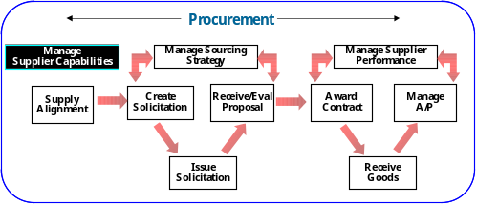
Procurement Process
Manage Supplier Capabilities
The first activity in the procurement process is understanding the supplier capabilities:
Who are my suppliers?
What are their capabilities?
How is their performance?
Who are their other clients?
Before we can issue a solicitation for a product, we must understand a supplier’s capability to provide the product.
Financial Condition
Supplier Capacity
Inventory Policies
Industry
Benchmarks
Complexity of Manufacturing
Production Lead Time
Notes:
In order to developing the right sourcing strategy for the products we buy, we must first have a thorough understanding of our suppliers’ capabilities.
The better we understand our suppliers, the better we are in awarding contracts to the “right” supplier to meet our customers’ needs.
These are just some of the things we need to understand about our suppliers.
This is a significant area for improvement.
How many of you who are from procurement organizations really understand how your supplier runs their business and the performance/condition of that business?
Many don’t believe this is a factor…they simply issue the solicitation and whoever is the low bid, gets the work.
Best value contracting has helped us move in this direction (we are now understanding more about our suppliers’ capabilities. However, understanding supplier capabilities will allow us to structure our sourcing strategies in a manner where we (DLA) know the quality we are looking for before issuing the solicitation.
FINANCIAL CONDITION – we don’t want to award a contract to a supplier with financial problems – risk of company going out of business; risk of company performing poorly due to focus on solving financial problems vice serving customers.
INDUSTRY BENCHMARKS – are they the best at what they do?
SUPPLIER CAPACITY – can the supplier meet surge and sustainment needs in time of war? After all, that’s what we need to be prepared for.
COMPLEXITY OF MANUFACTURING PROCESS – this will enable us to better inform the planning team to meet unanticipated needs (be as procative as we can be).
INVENTORY POLICIES – how lean is the suppliers inventory policies? Will they be able to meet our needs in a short notice?
PRODUCTION LEAD TIME – how long does it actually take to make the product; again, enables us to be more proactive.

Slide 35
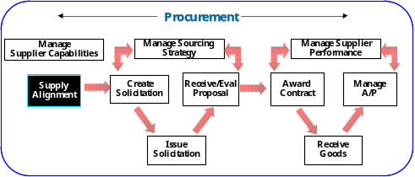
Procurement Process
Supply Alignment
The next step in the procurement process is Supply Alignment:
Does the purchase request support the supply plan?
Do our suppliers have capacity problems?
How often should we meet to ensure alignment?
Supply Alignment is a coordination process where Planning and Procurement meet to identify issues and solve problems before they adversely impact the customer
Identify supplier problems (capacity problems, closing of a production facility, etc.).
Solve problems with the Attainment to Plan KPI (determine why the supply plan and a contract are not balanced)
Notes:
Concurrent with maintaining our understanding of supplier capabilities, we must remain actively involved in the supply alignment process.
This will be our NEW insight into our customer needs.
The Supply Alignment Process:
Facilitates communication
Enables the proactive supply chain
Solves problems before they hit critical mass
This entire process breaks down walls that typically exist between planning and procurement.

Slide 36
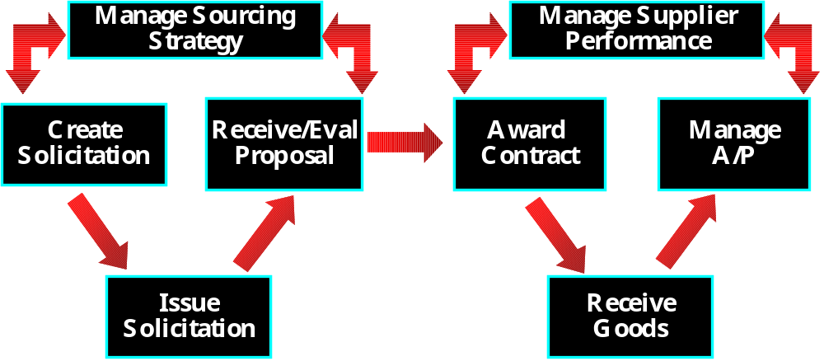
Procurement Process
Understanding Suppliers and Customers
With a full understanding of supplier capabilities and the customer’s requirements, the procurement organization now has the proper tools to execute a sourcing strategy:
Sourcing Requirements
Supply Plan
Purchase Request
Supplier Capabilities
Notes:
The biggest take-away from this is understanding that through the supply alignment process and a better understanding of our customers, we will be equipped with the right information to better service the warfighter.
If the supply plan is executed properly, the customer needs will be met.
With this information, the procurement organization can focus on suppliers, their capabilities, and developing the best procurement strategy.
With the Supply Plan, knowledge of Supplier Capabilities, and a Purchase Request (funding), we are ready to move on to the next stage in the procurement process: executing a sourcing strategy.

Slide 37
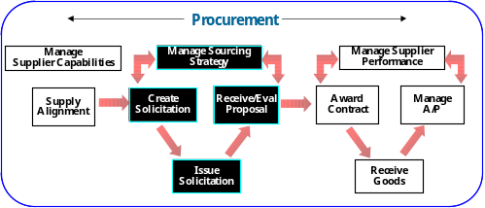
Procurement Process
Managing the Sourcing Strategy
Before the release of a solicitation (request for proposal) for a product, we must first determine how the item should be procured (sourced).
Who are my capable suppliers?
Type of
relationship with supplier?
Number of available suppliers?
Value of the product?
One approach in selecting the right sourcing strategy is the use of Quadrant Analysis:
High
Sourcing Management
Supply Management
Critical
Items
Strategic
Items
Risk or Exposure of Product
Purchasing Management
Materials Management
Tactical
Items
Leverage
Items
Low
Value of Product
High
Notes:
Before buying a product or service, a number of key questions should be answered, which will ensure that we buy what we’re looking for in a manner that supports our procurement strategy.
The use of Quadrant Analysis is critical in executing a procurement strategy that meets our customer needs.
Risk/Exposure
Strategic importance of item (criticality)
Ability to utilize substitutes
Number of available suppliers
Concentration of suppliers
Lead time risks/geographic scope
Cost/Value
Total item value (by value we mean to the warfighter)
Impact on product/service quality
Impact on business growth
Impact on qualitative factors (e.g., safety, environment, etc.)
IMPORTANT NOTE: DO NOT CONFUSE “CRITICAL ITEMS” WITH THE VALUE OF AN ITEM. BY CRITICAL, WE CONSIDER BOTH ITS VALUE AND THE RISK/EXPOSURE ASSOCIATED WITH THE PRODUCT. FOR EXAMPLE, IF THE ITEM IS OF RELATIVELY LOW VALUE, BUT THERE ARE VERY FEW SUPPLIERS, THE ITEM SHOULD BE CONSIDERED CRITICAL BECAUSE IF THE FEW (OR ONE) COMPANY THAT PRODUCES THE PRODUCT GO OUT OF BUSINESS OR FAIL TO PRODUCE THE ITEM, YOU AS A COMPANY ARE LEFT WITH NO SOURCE OF SUPPLY AT ALL.

Slide 38
In performing Quadrant Analysis, we must evaluate the key attributes of the products/services we acquire as well as the suppliers who provide them
Procurement Process
Sourcing Strategy Approach
High
Critical
Strategic
Low Value
Few Suppliers
Stringent Requirements
High Value
Few Suppliers
Stringent Requirements
Strategy: Maintain quality
and continuity of supply
Strategy: Careful supplier
management
Risk or
Exposure
Tactical
Leverage
Low Value
Many Suppliers
High Value
Many Suppliers
Strategy: Reduce costs
using competition and
buying skills
Strategy: Minimize costs
Low
High
Value
Notes:
Each quadrant represents a characteristic of the product we’re buying, including the availability of suppliers.
For each product, we should consider risk and cost.
Tactical and Leverage buys warrant a Transaction Focus.
Critical and Strategic buys warrant a Relationship Focus.

Slide 39
Depending upon the industry/market conditions and commodity characteristics, we should select a sourcing strategy that is based on relationships or transactions:
Procurement Process
Sourcing Strategy Approach
Transaction
Focus
Relationship
Focus
Stable Market
Low Switching Cost
Many Buyers and
Suppliers
Mature Market
Non-Differentiated Products
No Development Costs
Market Volatility
Irregular, But Significant Demand Pattern
Large Purchase Relative to Industry Capacity
High Switching Costs
High Differentiated Products
High Development Costs
Notes:
Depending upon the market/industry conditions and the product characteristics, we should select either a relationship or transaction focused strategy.
Transaction Focus – A transaction focused strategy is used when the market conditions are generally stable, typically a mature market, where the switching cost to the organization are low and there is very little product differentiation.
Relationship Focus – A relationship focused strategy is used when there is market volatility, irregular, but significant demand, high switching costs and high development costs.
These strategies fit into our quadrant analysis.

Slide 40
Procurement Process
Sourcing Strategy Approach
Within each relationship / transaction focus area, there are three general sourcing strategy alternatives that reflect a range of market circumstances and the sourcing goals.
Relationship Focus
Long Term Contract
Strategic Alliance
Partnership
Strategy Alternatives
Spot Buys
Blanket Purchase Order
Pricing Contract
Transaction Focus
Notes:
Spot Buys – sourcing strategy where a product or service is sourced on a non-routine\irregular basis; strategy is typically used for “one-time buys” (short-term, one-time requirement) with market conditions that include volatile pricing and limited supplier differentiation
Blanket Purchase Orders – sourcing strategy where products or services are frequently required at irregular intervals; contract establishes standards terms and conditions for a period of typically one to two years
Pricing Contracts – sourcing strategy that focuses on obtaining a product or service at the “best-price” (cost is the number one consideration); typically involves products with little differentiation with significant volume; terms are typically two to three years
Long-Term Contracts – sourcing strategy that focuses on establishing and maintaining a relationship with a supplier/service provider where few are available and the product is moderately critical to services; switching cost are relatively high and the contractual relationship is generally three to five years; the Long-Term Contract differs from the Blanket Purchase Order in that the LTC establishes a set cost whereas BPA’s often have an open ended cost structure
Partnerships – sourcing strategy that focuses on a long-term relationship built upon mutual trust where the product or service is critical to the business; high switching cost are the norm and the contractual period is typically five to ten years; other common characteristics of this strategy include integrated supply chain planning, detailed performance measures to monitor the relationship, and such value added services as value engineering
Strategic Alliances – sourcing strategy that includes all elements of a partnership with the added creation of a separate organization dedicated to service a business/program
Supplier Service Level Agreement – a formal agreement between the a business and a supplier/service provider that contractually details the terms of performance required of the supplier/service provider and the obligations to the business (e.g., providing the supplier/service provider with certain information); agreement typically contains a scope/objective, detail of service to be provided, and the performance measurement standards to be met
In the next several slides, we will apply these concepts to items that DLA buys today.

Slide 41
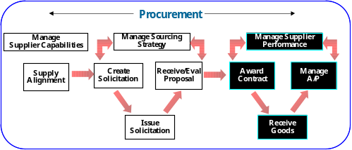
Procurement Process
Contract Award and Management
Once we have evaluated the proposals and made a contract award that is aligned with our procurement strategy, we must manage the supplier’s performance.
What tools help us manage the supplier’s performance?
How will we manage payment to the supplier?
Managing the Accounts Payable process is a fundamental component of supplier management.
The organization must establish contracts that incorporate accounts payable leading practices in order to manage the process.
A Supplier Service Level Agreement (SLA) is a formal agreement between parties regarding services to be performed by the parties.
Notes:
Each SLA should contain the following:
Introduction/Objectives
Scope
Service (what will the supplier provide DLA; what will DLA provide the supplier – planning, communications, service levels, roles & responsibilities, etc).
Performance Targets (we will provide the supplier with some of our KPIs/metrics to better educate them on our goals and objectives as well as targets for service levels; they may provide us the same
As we can see, there are a number of new process in managing the accounts payable process that result in dramatic improvements to the organization.
Evaluated Receipt Settlement – a financial management program all of the information in the invoice is already transmitted in a Shipment and Billing Notice electronically (typically an 857 EDI transaction); through this program, the invoice is eliminated and the shipment and billing notice is used to pay the vendor resulting in cost savings to the business or organization.
Paperless Invoice – electronic document transmitted by a supplier/service provider that details information regarding the receipt of a product or service.

